Slide 1
DevSecOps Improvement Update
Core Team – Kim, Pedro, Lewis, Godfrey, Miguel, Sam & Victor

Slide 2
DevSecOps Initiative Overview
Improve security, quality and compliance of the Mojaloop Platform by leveraging mainly open source tools and community support.
Underpinning Principles:
Deep integration into DevOps and CI\CD processes ( All security must be automated gates to keep the DevOps workflow from slowing down)
Developer centric and inclusive ( Empower and delegate with trust security integration activities to the devops teams )
Open source first approach to tooling (Commercial tools to be considered only if open source tools does not fulfil the requirements)
Adapt Application Security to Cloud Native Technologies (Containers and Microservices)

Slide 3
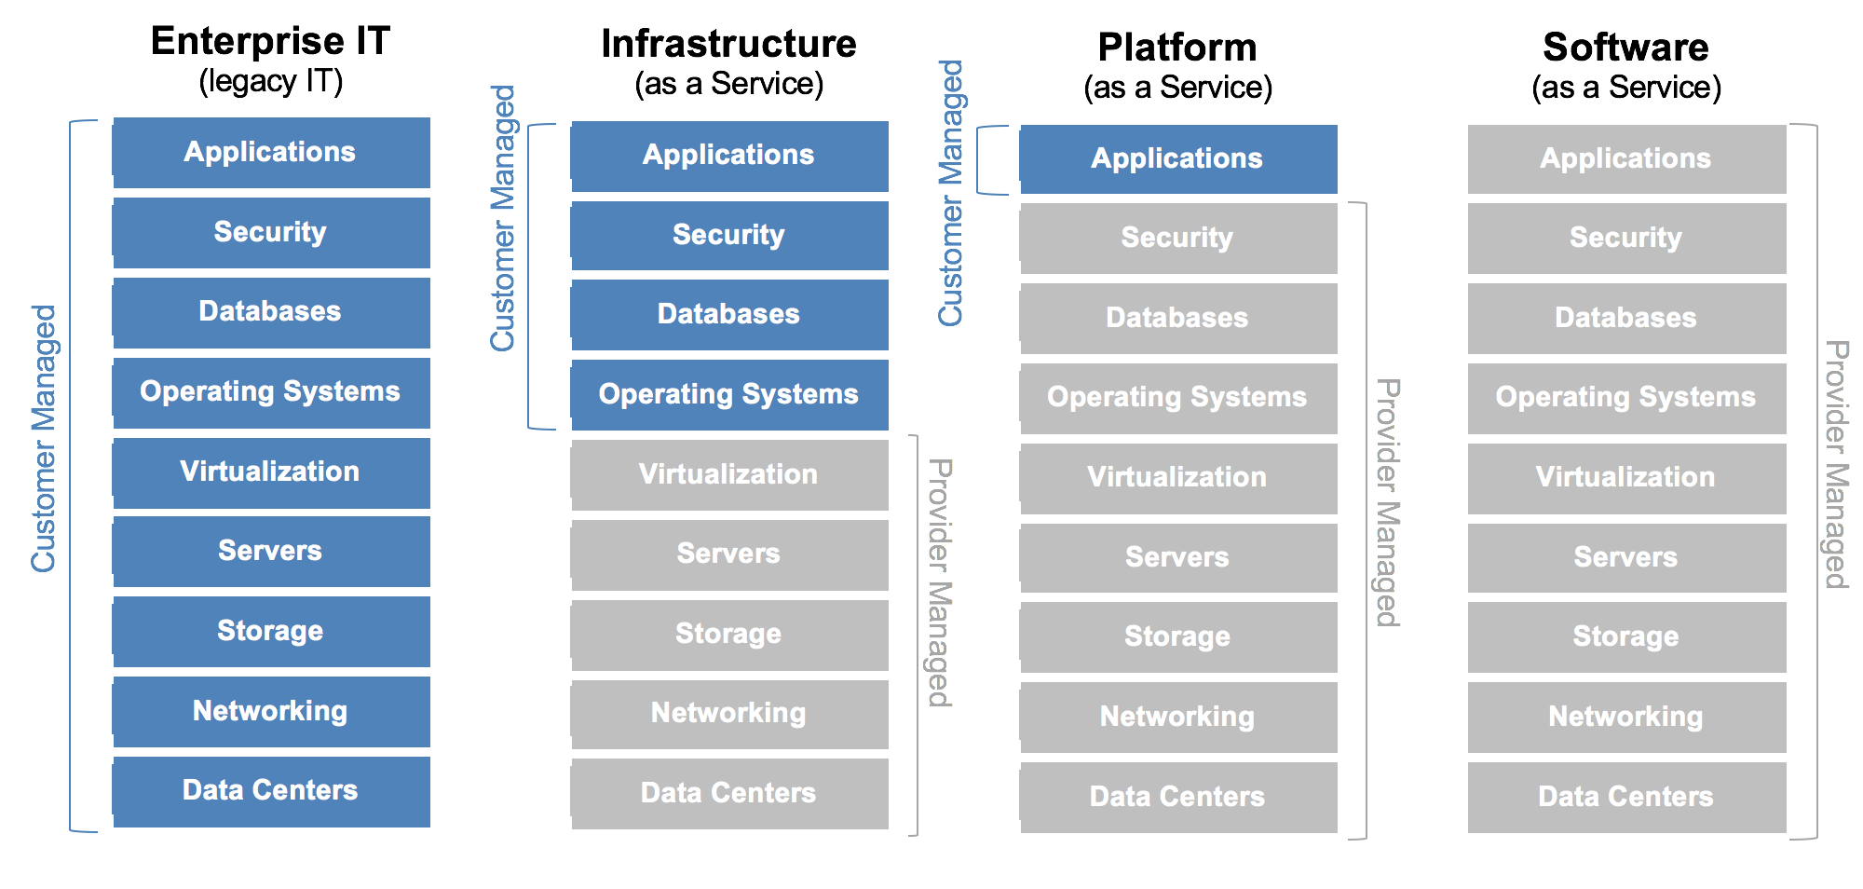
DevSecOps Model & Framework
On Premise
Cloud
Container
SaaS
Implementor Managed
Implementor Managed
Implementor Managed
Trust gap
Trust gap
Trust gap
3
Output:
Provision of a security guidelines based on the Platform as a Service Model – Implementers to adapt to their own environment and policies
Alignment to CIS benchmarks and CSA cloud security essentials for IaaS and PaaS

Slide 4
DevSecOps Epics
Code Level Security Epics – PI 7 Focus
Epic 3: Open Source Quality & Security (Vulnerabilities, Licence compliance, & operational risk)
Epic 4: Static Code Analysis (SCA) (Dev, Build & Release)
Epic 5: Container Security (Create, Release & Runtime)
Solution Wide Architecture Epics – Backlog for PI 8
Epic 1: JavaScript to Typescript Conversion (Typescript preferred but not mandated)
Epic 2: Architecture / Solution wide concerns (Identities, Service to Service Authentication, API GW etc..)
Epic 6: Threat Modelling (STRIDE Model)
Epic 7: Cloud Security (Cloud Agonistic – CIS Benchmarks & CSA Essentials)
Epic 8: Mojaloop DevSecOps Model (PaaS based Golden Standard )
Under Discussion – Backlog for PI 8 if approved
Epic 9 : GDPR Compliance ( Focusing on the data security technical requirements)
Epic 10: PCI Compliance ( Limit scope to ATM integration)
Epic 11 : Mojaloop Bug Bounty Programme (Vulnerability Reward Programme)

Slide 5
Container Security & Open Source Security - Tools Integration Update
It's coffee time...
Oops I spilled my coffee
No coasters over here
Lewis & Victor

Slide 6
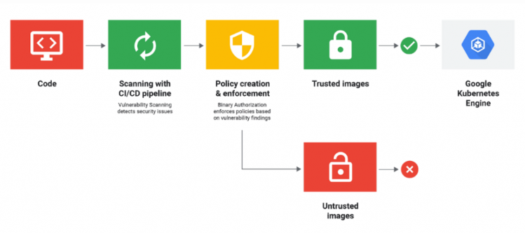
DevSecOps - How it all fits
Code
Scanning in CI/CD Pipeline
Policy Creation and Enforcement
Trusted Images
Deployed Secure packages / Continuous Monitoring
Proposed tools are swappable at implementation meaning - they can be replaced
Current tests conducted using base profiles / policies
Additional work required to evaluate specific policies depending on implementation security requirements.
Untrusted / Non Compliant Images

Slide 7
Epic 3: Open Source Quality & Security #1154 license-scanner updates
Change from blacklist to whitelist model
Modules* | Jan-20 | Oct-19
Top-level module references (directly in package.json, not nested dependencies)
Total first-level module dependencies: | 382 | 378
Unique first-level module dependencies: | 131 | 127
Total module references (in package-lock.json files, all nested dependencies)
Total module dependencies: | 16,758 | 15,813
Unique module dependencies: | 1567 | 1457
*Across active repos

Slide 8
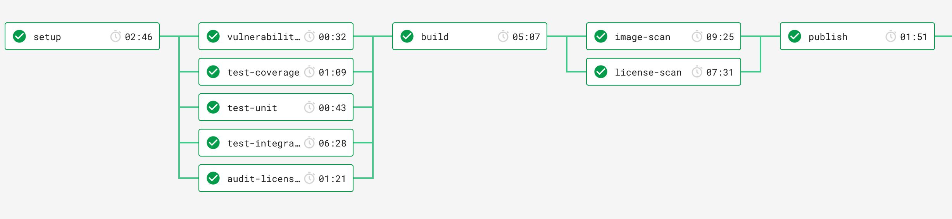
Epic 5: Container Security Tools anchore-cli, AppArmor
Anchore: static container analysis tool
‘Deeper’ scans than npm vulnerabilities alone
Now integrated as part of our container + helm release cycle

Slide 9
Epic 5: Container Security Tools Anchore-cli, AppArmor
Produces image summaries in .json files
Built automated tools for summarizing into excel/csv:
 | bulk-api-adapter | central-event-processor | central-settlement | email-notifier | ml-api-adapter | mojaloop-simulator | quoting-service
Critical | 0 | 0 | 0 | 0 | 0 | 2 | 0
High | 4 | 4 | 4 | 4 | 4 | 20 | 4
Medium | 6 | 6 | 9 | 5 | 5 | 9 | 6
Low | 2 | 2 | 2 | 2 | 2 | 4 | 2

Slide 10
WARNING:
JSON file snippets ahead.

Slide 11
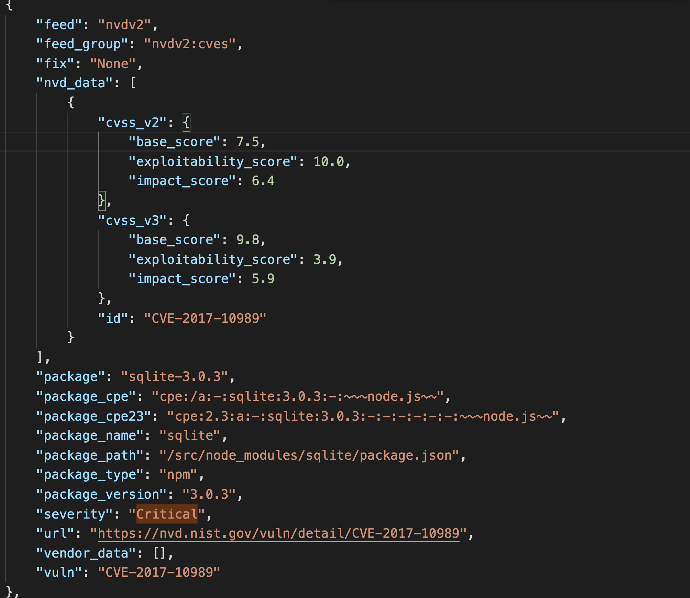

mojaloop-simulator_v8.8.0-snapshot-vuln.json
momoa_horseback_jason.png

Slide 12
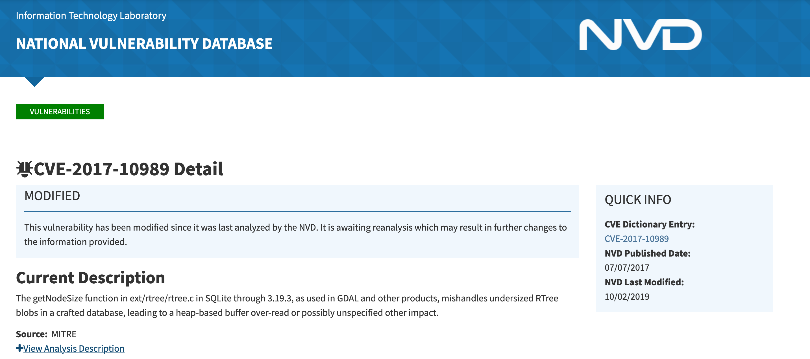
https://nvd.nist.gov/vuln/detail/CVE-2017-10989

Slide 13
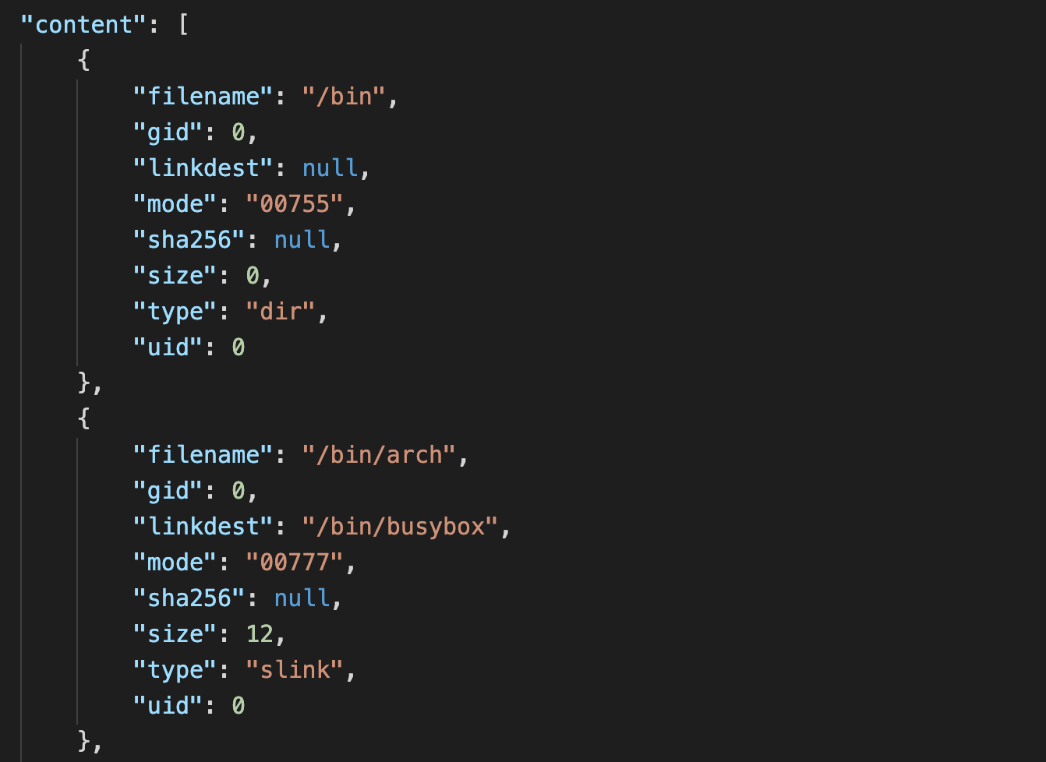

mojaloop-simulator_v8.8.0-snapshot-content-files.json
momoa_frangapani_jason.jpeg

Slide 14
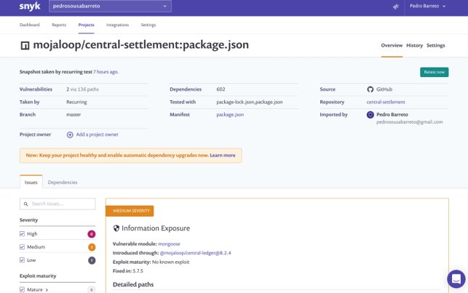
Epic 3: Open Source Quality & Security #1155 snyk for app scanning
snyk.io
"Enabling more than 400,000 developers to continuously find and fix vulnerabilities in open source libraries and containers"

Slide 15
Epic 3: Open Source Quality & Security #1155 snyk for app scanning
 | High | Med | Low
bulk-api-adapter | 0 | 0 | 0
central-event-processor | 0 | 0 | 0
central-settlement | 0 | 1 | 1
email-notifier | 0 | 0 | 0
ml-api-adapter | 0 | 0 | 0
mojaloop-simulator | 0 | 0 | 0
quoting-service | 0 | 0 | 1
 | Level | Type | Module | Fix available? | Exploit available? | Link
central-settlement | Med | Information Exposure | mongoose | yes | no | https://app.snyk.io/vuln/SNYK-JS-MONGOOSE-472486
central-settlement | Low | Information Disclosure | mongoose | yes | yes | https://app.snyk.io/vuln/SNYK-JS-KINDOF-537849
quoting-service | Low | Information Disclosure | kind-of (from knex) | yes | yes | https://app.snyk.io/vuln/SNYK-JS-KINDOF-537849

Slide 16
Epic 3: Open Source Quality & Security #1155 snyk for app scanning
Pros
Integrates with CircleCI (has specific orb)
Can be executed locally using a CLI (ex: pre-commit hooks)
Can ignore specific vulnerabilities or fail only above certain threshold (high/med/low)
Slack integration and email reports
Ability to automatically create a PR with the fixes (package version upgrades)
Unlimited tests for OSS public projects
Large and up-to-date vulnerability database
Cons
Fancy reports not available in free version
License compliance management not available in free version
API not available in free version

Slide 17
Epic 3: Open Source Quality & Security #1155 snyk for app scanning
​ | Level​ | Type​ | Component​ | Fix available?​ | Exploit available?​ | Link​
ml-api-adapter​ | High​ | Out-of-bounds Write​ | musl@1.1.20-r4​ | yes​ | no​ | https://app.snyk.io/vuln/SNYK-ALPINE39-MUSL-458529​
ml-api-adapter​ | High​ | Arbitrary File Overwrite​ | node@10.15.3​ | yes(10.18.0)​ | yes​ | https://app.snyk.io/vuln/SNYK-UPSTREAM-NODE-538285​
ml-api-adapter​ | High​ | Arbitrary File Write​ | node@10.15.3​ | yes(10.18.0)​ | yes​ | https://app.snyk.io/vuln/SNYK-UPSTREAM-NODE-538286​
ml-api-adapter​ | Low​ | Denial of Service (DoS)​ | node@10.15.3​ | yes(10.16.3)​ | no​ | https://app.snyk.io/vuln/SNYK-UPSTREAM-NODE-459326​
ml-api-adapter​ | Low​ | Unauthorized File Access​ | node@10.15.3​ | yes(10.18.0)​ | yes​ | https://app.snyk.io/vuln/SNYK-UPSTREAM-NODE-538287​
Others ​ | ** likely same as ml-api-adapter as they share the same base image **​

Slide 18
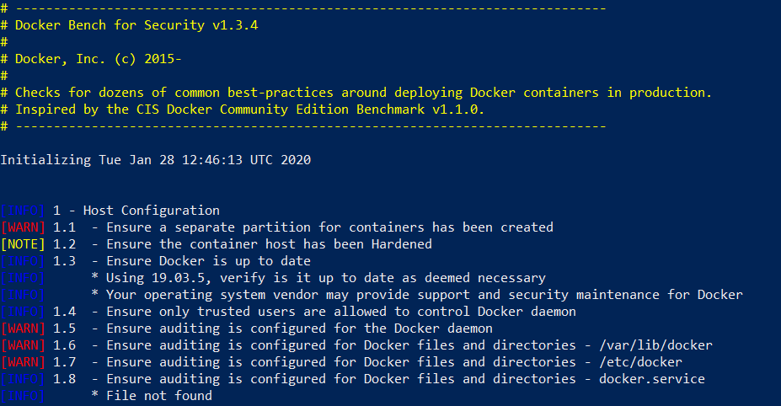
Epic 3: Open Source Quality & Security
Docker-bench-security
A script that checks for best-practices around deploying Docker containers in production.
Uses CIS Benchmark v.17.06 - https://www.cisecurity.org/benchmark/docker/
Conducts 105 security tests across Docker runtime environment.

Slide 19
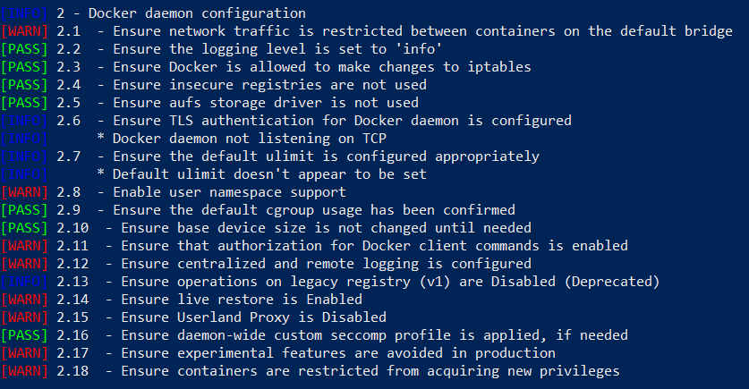
Epic 3: Open Source Quality & Security
Docker-bench-security

Slide 20
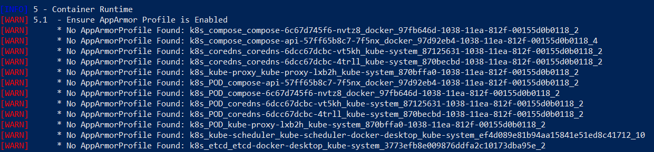
Epic 3: Open Source Quality & Security
Docker-bench-security

Slide 21
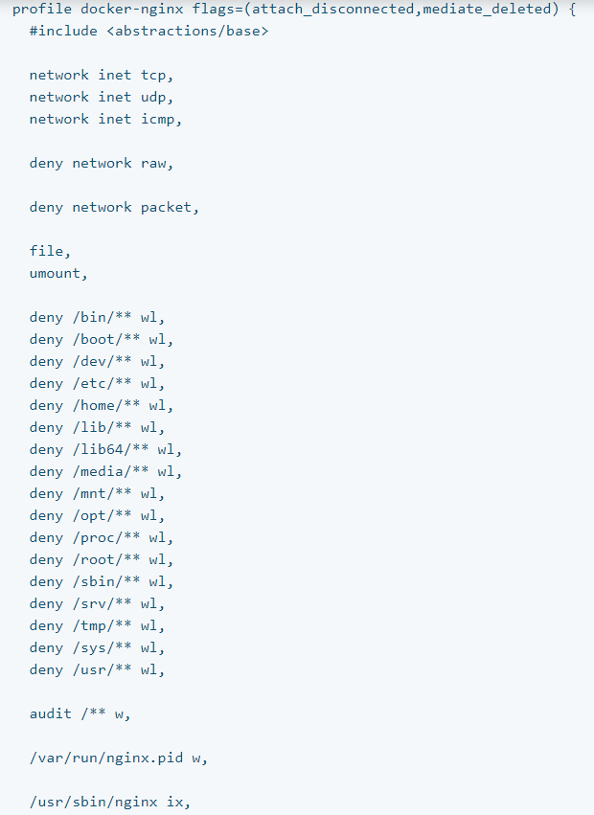
Epic 3: Open Source Quality & Security
AppArmor runtime security
AppArmor (Application Armor) is a Linux security module that protects an operating system and its applications from runtime security threats.
Docker expects to find an AppArmor policy loaded and enforced. It automatically generates and loads a default profile for containers named docker-default.
Profiles can allow capabilities like network access, raw socket access, and the permission to read, write, or execute files on matching paths.

Slide 22
Challenges / Next Steps
Continuous monitoring of the threat landscape – Including public concerns on Mojaloop Security.
Hold formal feedback sessions with implementers.
Safely navigate through a large landscape of open source security tools.
Continuous tool update without impacting the CI/CD workflow process.
Keep compliance initiatives use case driven.

Slide 23
Thank You Questions?
More coffee stains
Oh no! A spill!

Slide 24
Appendix

Slide 25
Epic 1: Javascript to Typescript Conversion
Typescript Pros
Type checking makes it easier to find bugs that usually get caught only at runtime (no test substitute)
OOP allows for "interface oriented development” which is an enabler of Single Responsibility Principle - which leads to scalable code and dependency management
Easier to refactor when code gets bigger
TS and JS can co-exist on the same project, no all of nothing approach required
A significant number of large JS libraries and frameworks are already TS

Slide 26
Epic 1: Javascript to Typescript Conversion
Typescript Cons
Additional dev tools/steps - more setup time
Devs have to learn TS
TS on its own is no silver bullet - bad developers can still produce bad TS code
Might detract JS purists from contributing - not true anymore since the majority of JS devs can do TS (source https://stackshare.io/typescript)

Slide 27
Epic 1: Javascript to Typescript Conversion
Typescript Fallacies
Development takes longer
Cost of software is in maintaining it, not the initial code - TS can improve maintainability of the code
Prevent recruiting good JS people
“good JS” often translates to hard to maintain procedural code.
Plus, good developers can use many tools, including many languages.
Recommendation
Plan the update of core and shared repos to Typescript
Start with shared libraries first, then move on to
Enforce new core and shared repos to use Typescript

Slide 28


ML OSS: Release Mechanism with Security Checks
Automated Checks
Threat Modelling
Automated Checks
Dynamic Analysis -
AppArmor, Docker-Bench-Security
Secure by design.
Static Analysis – Code Reviews
NPM, Snyk, Licence, Anchore-CLI
QA
Feature
Grooming
Eg: v5.5.x* Release
QA is performed on a deployment regularly & on-demand.. Bugs are logged for issues found & triaged
A feature or high level topic is identified during Program Increment(PI) planning
Stories are groomed and Acceptance Criteria finalized
Implementation
Development, PR, Merging to master, CI process
Announcements made
PI Planning
Sprint
Sprint/Release/Schedule
Setup/helm
Priority issues, bugs
Release
Deploy
Announcements made
PI/Sprint
Bug Fixes, Hot Fixes
Sprint
Bug Fixes, HotFixes, Priority Features added mid-sprint
Release made
Epics, Stories
A release is made on GitHub & package/image pushed to npmjs or dockerhub. It is then deployed on Dev environment (on AWS). This happens multiple times in a Sprint
Release to Community
Based on Objectives of a PI, Epics and Stories based on features are accepted at PI/Sprint level
Sprint Planning
If there are no high-priority bugs, release is considered stable. A way to maintain the list of Last Known Good set of versions is in the works
* Inspired by SemVer; x.y.z – where ‘x’ is the PI number, ‘x.y’ is the Sprint number and ‘z’ is the number of release in a particular sprint
Stories are prioritized and added to particular Sprint Milestones
Note: This depicts a single iteration that happens multiple times over the course of a PI
ModusBox for BMGF
Notes:
Nico

